Slide 1
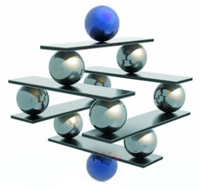
Introduction to SOAP, WSDL & Web Services
HNDIT 2411 Lecture 11

Slide 2
What is SOAP
RPC is an obvious and popular paradigm for implementing the client-server model of distributed computing.
Different RPC protocols exist today.
  Sun RPC, DCE/RPC, DCOM, CORBA
Most of the RPC protocols are too low level and certainly not compatible among each other (gateways are needed)
Since RPC represents a compatibility and security problems, firewalls and proxy servers will normally block this kind of traffic.
To address this problem, XML was used to define SOAP.
Soap uses HTTP/SMTP as the communication protocol

Slide 3
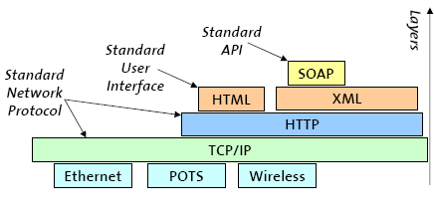
Why is SOAP
XML-based protocol for exchanging information between applications
Primary focus of SOAP is Remote Procedure Calls transported via HTTP
Similar to DCOM, CORBA, and Java RMI, the main difference is that SOAP messages are written entirely in XML
SOAP is therefore uniquely platform and language independent
For example, a SOAP Java client running on Linux or a Perl client running on Solaris can connect to a Microsoft SOAP server running on Windows 2000

Slide 4
How SOAP works
RPC Using HTTP
  At the Client
    Turns the RPC call into a XML document
  Transports the XML data over HTTP (or SMTP) (Client to Server)
  At the Server
    Turns the XML document into a procedure call
    Turns the procedure’s response into a XML document
  Transports the XML data over HTTP (or SMTP) (Server to Client)
  At the Client
    Turns the XML data into the response to the RPC

Slide 5
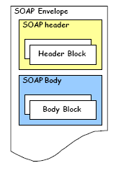
Structure of a SOAP Message
SOAP is based on message exchanges.
Messages are seen as envelopes where the application encloses the data to be sent.
A message has two main parts; header and body, which both can be divided into blocks.
SOAP does not specify what to do in the body, it only states that the header is optional and the body is mandatory.
The use of header and body, however, is implicit. The body is for application level data. The header is for infrastructure level data.

Slide 6
SOAP Header
The header is intended as a generic place holder for information that is not necessarily application dependent (the application may not even be aware that a header was attached to the message).
Typical uses of the header are: coordination information, identifiers (for, e.g.: transactions) and security information (e.g.: certificates)

Slide 7
SOAP Body
The body is intended for the application specific data contained in the message.
Also it may contain a Fault entry Section (for reporting errors in processing a SOAP message)

Slide 8
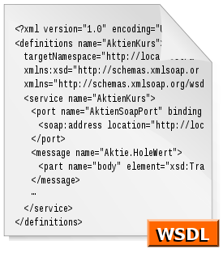
Introduction to WSDL

Slide 9
What is WSDL?
WSDL stands for Web Services Description Language
WSDL is as XML document
WSDL is used to describe Web services
  It specifies the location of the service and the operations (or methods) the service exposes
WSDL is also used to locate Web services

Slide 10
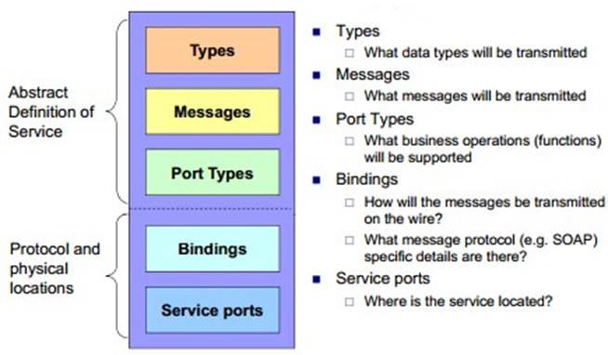
The WSDL Document Structure
A WSDL document describes a web service using these major elements:

Slide 11
WSDL Types
The <types> element defines the data types that are used by the web service.
For maximum platform neutrality, WSDL uses XML Schema syntax to define data types.

Slide 12
WSDL Messages
The <message> element defines the data elements of an operation.
<message name="newTermValues">
<part name="term" type="xs:string"/>
<part name="value" type="xs:string"/>
</message>
Each message can consist of one or more parts. The parts can be compared to the parameters of a function call in a traditional programming language.

Slide 13
WSDL Port
A WSDL port describes the interfaces (legal operations) exposed by a web service.
It defines a web service, the operations that can be performed, and the messages that are involved.
Operation Types
  One-way
  Request-response
  Solicit-response
  Notification

Slide 14
One-Way Operation
<message name="newTermValues">
<part name="term" type="xs:string"/>
<part name="value" type="xs:string"/>
</message>
<portType name="glossaryTerms">
<operation name="setTerm">
<input name="newTerm" message="newTermValues"/>
</operation>
</portType >

Slide 15
Request-Response Operation
<message name="getTermRequest">
<part name="term" type="xs:string"/
</message>
<message name="getTermResponse">
<part name="value" type="xs:string"/>
</message>
<portType name="glossaryTerms">
<operation name="getTerm">
<input message="getTermRequest"/>
<output message="getTermResponse"/>
</operation>
</portType>

Slide 16
WSDL Binding
WSDL bindings defines the message format and protocol details for a web service.
The binding element has two attributes - name and type.
  The name attribute defines the name of the binding, and the type attribute points to the port for the binding.
The soap:binding element has two attributes - style and transport.
The operation element defines each operation that the port exposes
  For each operation the corresponding SOAP action has to be defined. You must also specify how the input and output are encoded. .
Notes:
When you create a WSDL binding that maps a portType's operations to SOAP messages sent over HTTP, you have to specify whether the SOAP messages contain literal or encoded instances of the schema constructs the operations use. If you choose "literal," you are saying that the XML Schema constructs your WSDL definitions refer to are concrete specifications of what will appear in your SOAP message bodies. If you choose "encoded," you are saying that the XML Schema constructs your WSDL definitions refer to are abstract specifications of what will appear in your SOAP message bodies; these can be made concrete by applying the rules defined by SOAP encoding. (The WSDL specification allows other encoding schemes as well, but alternatives are rarely if ever used.)

Slide 17

Introduction to Web Services

Slide 18
Web Services

Slide 19
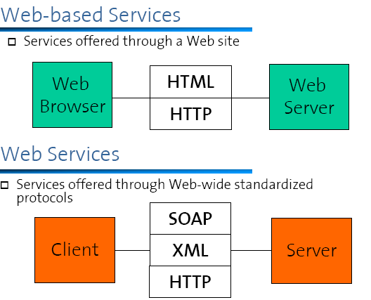
Web-based Services & Web Services

Slide 20
Web Service (W3C Definition)
“A Web service is a software application identified by a URI, whose interfaces and bindings are capable of being defined, described and discovered as XML artifacts. A Web service supports direct interactions with other software agents using XML-based messages exchanged via the Internet based protocols”

Slide 21
Web Service
Web Service definition by W3C emphasizes different aspects:
  In order to be accessible, a service should be defined, described and discovered.
  XML is the foundation for all standards that are going to be used (SOAP, WSDL, UDDI)
  Web services are components that can be readily integrated into more complex distributed applications.
  Web services are meant for software based consumption (while Web-based applications are meant to be used by humans equipped with a WWW browser)

Slide 22
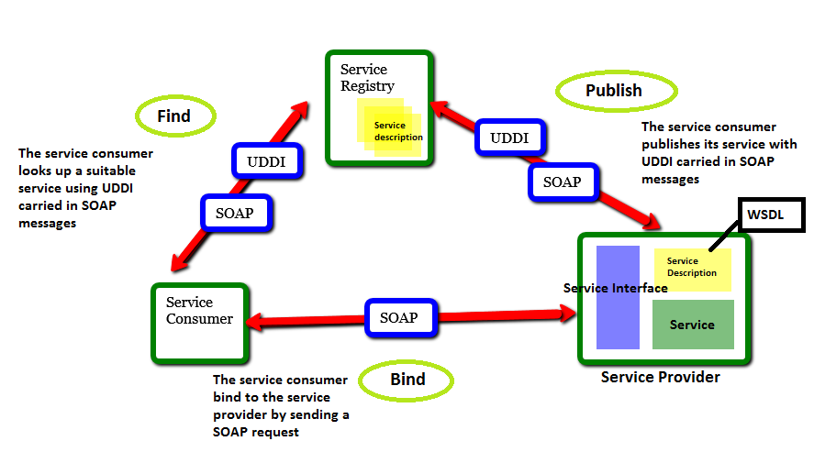
Web Service Architecture

Slide 23
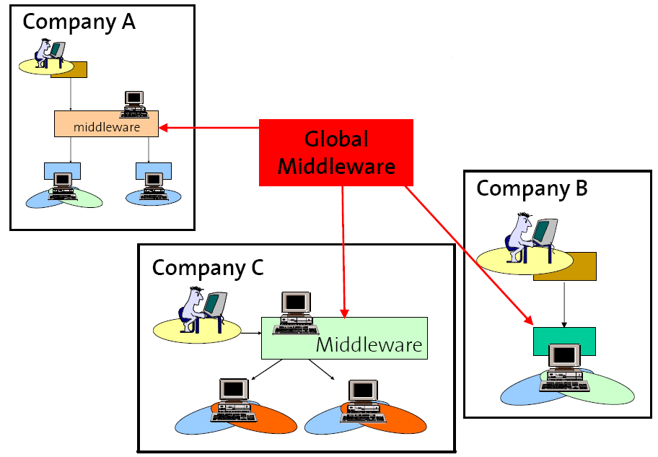
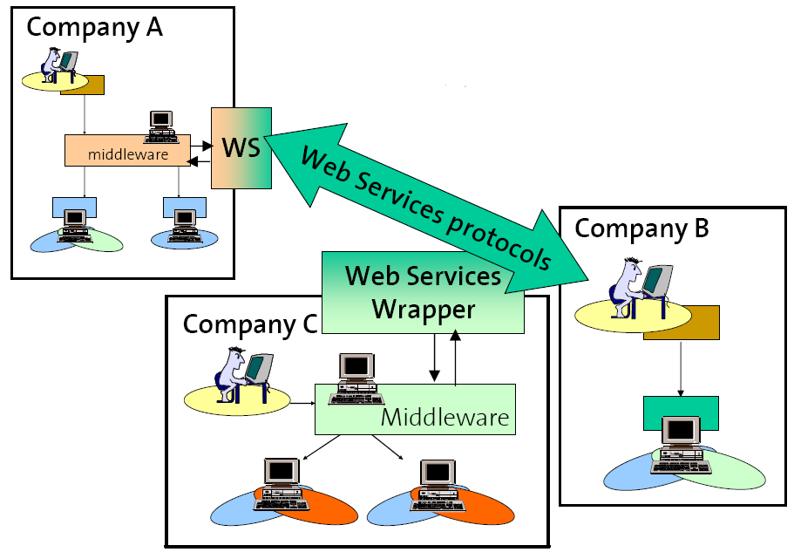
Benefits of Web Services
The Web services architecture represented by SOAP, UDDI, and WSDL is a direct descendant of conventional middleware platforms
They can be seen as the most basic extensions that are necessary to allow conventional synchronous (RPC=based) middleware to achieve interoperability

Slide 24
Benefits of Web Services
Platform independence (Hardware, OS)
Programming language neutrality
Portability across Vendor/Middleware tools

Slide 25
SOA in brief
•
SOA is an architectural style for building software applications that use services available in a network such as the web promotes loose coupling between software components so that they can be reused
Applications in SOA are built based on services
A service is an implementation of a well-defined business functionality
•
•
•
•
services can
applications
then be consumed by clients in different
or business processes

Slide 26
Web services and SOA
•
Web services are software systems designed to support
interoperable machine-to-machine interaction over a network
•
Interoperability is gained through a set of XML-based
standards, such as WSDL, SOAP, and UDDI
Standards provide a common approach for defining,
publishing, and using web services.
SOA and web services are two different things
open
•
•
•
But web services are the preferred standards-based way
to
realize
SOA

Slide 27
Importance of Service-Oriented Architecture
Web services technology has now advanced so that functionalities available in ERPs and various other systems can easily be published into intranets and internet for remote execution using SOAP, WSDL and UDDI.
SOA, now brings web services implemented using BPM tools.
It makes it possible to automate invocation of web services according to business rules.

Slide 28
Java EE platform
In the current trend SOA's are realized through web services
The Java EE platform enables you to build and deploy web services in your IT infrastructure on the application server platform provides the tools you need to quickly build, test, and deploy web services.
Provides clients that interoperate with other web services and clients Provides clients that interoperate with other web services and clients
enables businesses to expose their existing J2EE applications as web services.

Slide 29
Types of Web Services
•
On a technical level, web services can be implemented in
various ways
The two types of web services discussed in this section can be distinguished as “big”(SOAP) web services and “RESTful” web services.
Big web services use XML messages that follow the Simple Object Access Protocol (SOAP) standard, an XML language defining a message architecture and message formats
•
•
•
In Java EE 6, JAX-WS API provides the functionality
for “big”
web
services

Slide 30
RESTful Web Services
•
In Java EE 6, JAX-RS provides the functionality for
Representational State Transfer (RESTful) web services
REST is well suited for basic, ad hoc integration scenarios
RESTful Web Services are completely stateless
RESTful web services, often better integrated with HTTP
than SOAP-based services
•
•
•
•
Do not require XML messages
definitions
or WSDL
service–API

Slide 31
SOAP vs RESTful Web Services
•
REST is almost always faster than SOAP. The main
advantage of SOAP is that it provides a mechanism for services to describe themselves to clients, and to advertise their existence.
REST is much more lightweight
REST has lower bandwidth and shorter learning curve
REST clients have to know what to send and what to
•
•
•
expect.
clients
On the other way SOAP describe it itself to the

Slide 32
Building RESTful Web Services with JAX-RS
•
JAX-RS is a java language specification for Restful web
services
There are different implementations exist for JAX-RS
specification, some are
•
–
–
–
–
Jersey, the reference implementation
RESTeasy from Jboss
Oracle,
Apache
Restlet,
Wink from apache
created by Jerome Louvel

Slide 33
JAX-RS Spcification
•
Root resource classes
–
–
entry point into Web services
Its methods either directly implement operations on the
resource or provide access to sub-resources.
The class must be decorated with the @Path annotation
The class must have a public constructor for the runtime to invoke
At least one of the classes methods must either be decorated with an HTTP verb annotation or the @Path annotation
–
–
–

Slide 34
JAX-RS Spcification
•
Resource methods
–
–
methods annotated using JAX-RS annotations
They have one of the HTTP method annotation specifying the types of requests that the method processes
must be public
must be decorated with one of the HTTP method annotations
must not have more than one entity parameter
–
–
–

Slide 35
Basic JAX-RS annotations
•
JAX-RS defines a set of annotations that provide this basic
information.
The most basic pieces of information required by a RESTful Web
service implementation are
•
–
–
The URI of the service's resources
how the class' methods are mapped to the HTTP
verbs
All resource classes must have at least one of these
annotations.@Path,@DELETE,@GET,@POST,@PUT
@HEAD
•

Slide 36
A simple root
resource
class
import javax.ws.rs.GET;
import javax.ws.rs.Path;
import javax.ws.rs.PathParam;
import javax.ws.rs.core.Response;
1.Resource can be accessed from root path of appliction
This resource method invoked when server
receives HTTP GET method
@Path("/")
public class HelloService {
Resource name relative to resource path of
class(1)
@GET
@Path("/Hello/{name}")
Resource method parameter
public Response printMessage(@PathParam("name") String name) {
return Response.status(200).entity("Hello " + name).build();
}
Resource method
}

Slide 37
Invoking the PrintMessage
The @Path annotation specifies the URI of a resource
Eg.
@Path("resourceName/{param1}/{param2}")
Service
In the previous example we will assume the web application
root path is HelloRestEasy then the user type the URL
http://localhost:8080/HelloRESTEasy-1.0-
SNAPSHOT/Hello/Jhon
Then the expected output is
Hello Jhon
We will discuss “1.0-SNAPSHOT” part later

Slide 38
Java annotations
•
•
The Annotation is
meta data about the program itself
In other words, organized data about the code, embedded
within the code itself
It can be parsed by the compiler and annotation processing tools
Many APIs require a fair amount of boilerplate code
•
•
•
This boilerplate could be generated automatically
by
a tool
if
the
program were “decorated” with annotations

Slide 39
HTTP(Hyper Text Transfer Protocol)
•
HTTP is an application layer protocol functions as a
request-response protocol in the client-server computing mode
A web browser, for example, may be the client and an application running on a computer hosting a web site may be the server
The server, which provides resources such as HTML files and other content, or performs other functions on behalf of the client
•
•
•
Server
returns a response message to the client

Slide 40

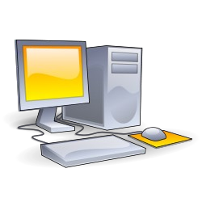
HTTP(Hyper
Text Transfer Protocol)
Some Web server
Eg. Appache IIS Tomcat GlashFish
2.HTTP Server (Eg.Tomcat)
respond with the reply
1.HTTP client (Eg.browser)
send a HTTP request with particular request method(Eg. GET)

Slide 41
HTTP(Hyper Text Transfer Protocol)
•
•
Web services messages are typically conveyed using HTTP
HTTP defines methods (sometimes referred to as "verbs") to
indicate the desired action to be performed
resource
on
the
identified
•
Some mostly used
HTTP
methods
are
–
–
–
–
–
GET,
POST PUT DELETE HEAD

Slide 42
HTTP
Request
methods
•
GET
–
Requests a
using GET
effect
representation of the specified resource. Requests
should only retrieve data and should have no other
•
POST
–
Submits data to be processed (e.g., from an HTML form) to
identified resource. The data is included in the body of
the
the the
request. This may result in the creation of a new resource
updates of existing resources or both
or
•
PUT
–
DELETE
–
Uploads a representation of the specified
resource.
•
Deletes the specified resource.

Slide 43
Summary of JAX-RS Annotations
@Path
The @Path annotation’s value is a relative URI path
indicating where the Java class will be hosted: for
example, /helloworld. You can also embed variables in
the URIs to make a URI path template. For example,
you could ask for the name of a user and pass it to the
application as a variable in the URI: /helloworld/
{username}.
@GET
The @GET annotation is a request method designator
and corresponds to the similarly named HTTP method.
The Java method annotated with this request method
designator will process HTTP GET requests. The
behavior of a resource is determined by the HTTP
method to which the resource is responding.

Slide 44
Summary of JAX-RS Annotations
@POST
The @POST annotation is a request method designator
and corresponds to the similarly named HTTP method.
The Java method annotated with this request method
designator will process HTTP POST requests. The
behavior of a resource is determined by the HTTP
method to which the resource is responding.
@PUT
The @PUT annotation is a request method designator
and corresponds to the similarly named HTTP method.
The Java method annotated with this request method
designator will process HTTP PUT requests. The
behavior of a resource is determined by the HTTP
method to which the resource is responding.

Slide 45
Summary of JAX-RS Annotations
@DELETE
The @DELETE annotation is a request method
designator and corresponds to the similarly named
HTTP method. The Java method annotated with this
request method designator will process HTTP
DELETE requests. The behavior of a resource is
determined by the HTTP method to which the resource is responding.
@HEAD
The @HEAD annotation is a request method
designator and corresponds to the similarly named
HTTP method. The Java method annotated with this
request method designator will process HTTP HEAD
requests. The behavior of a resource is determined by
the HTTP method to which the resource is responding.

Slide 46
Summary
of JAX-RS Annotations
@Consumes
The @Consumes annotation is used to specify the MIME media types of representations a resource can consume that were sent by the client.
@Produces
The @Produces annotation is used to specify the MIME media types of representations a resource can produce and send back to the client: for example, "text/plain".

Slide 47
Example
import javax.ws.rs.GET;
import javax.ws.rs.Produces;
import javax.ws.rs.Path;
// The Java class will be hosted at the URI path "/helloworld"
@Path("/helloworld")
public class HelloWorldResource {
// The Java method will process HTTP GET requests
@GET
// The Java method will produce content identified by the MIME Media
// type "text/plain"
@Produces("text/plain")
public String getClichedMessage() {
// Return some cliched textual content
return "Hello World";
}
}

Slide 48
The @Produces Annotation
•
The @Produces annotation is used to specify the MIME
media types send back to the client
If @Produces is applied at the class level, all the methods in a resource can produce the specified MIME types by default
If applied at the method level, the annotation overrides any
@Produces annotations applied at the class level
•
•
•
If no methods in a resource are able to produce the
type in a client request, the JAX-RS runtime sends
MIME
back an
HTTP
“406 Not Acceptable” error.

Slide 49
Web Service Business Process Execution Language (WS-BPEL)
WS-BPEL is an OASIS standard for service orchestration
BPEL is a comprehensive workflow definition execution language specified in XML.
It can be thought of as a programming language but is more likely to be automatically generated from workflow diagrams.

Slide 50
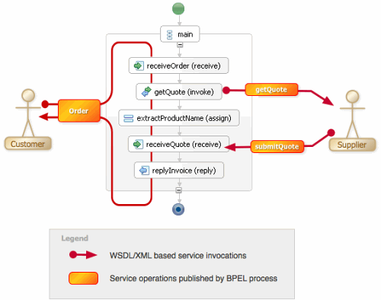
Web Service Business Process Execution Language (WS-BPEL)

Slide 51
BPEL Commands
Following are some commands of BPEL.
  Invoke an operation of a web service. <invoke>
  Wait for an external message. <receive>
  Generate a response for input. <reply>
  Wait for some time. <wait>
  Copy data between locations. <assign>
  Indicate that an error occurred or something went wrong. <throw>
  Terminate the entire service instance. <terminate>
  Define a sequence of steps. <sequence>
  Branch using a case statement. <switch>
  Define a loop. <while>
  Execute one alternative. <pick>
  Execute in parallel. <flow>

Slide 52
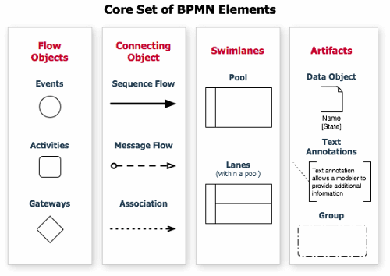
Business Process Management Notation

Slide 53
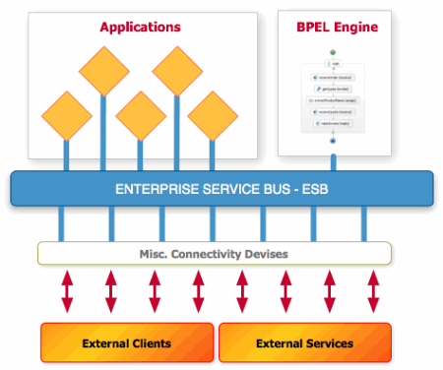
Enterprise Service Bus (ESB)
In computing, an enterprise service bus (ESB) consists of a software architecture construct which provides fundamental services for complex architectures via an event-driven and standards-based (the bus) - Wikipedia

Slide 54
Enterprise Service Bus (ESB)
The idea of an ESB is that many components can connect in a standardized way and then communicate over the bus with any other component.
Standardized (usually WSDL/XML based) messages are exchanged on that bus.
Set of adapters act as gateways between a protocol like e.g. SOAP over HTTP, email, FTP and RMI

